Slide 1

INFM 603 ALUMNI DATA AND ENGAGEMENT TRACKING SYSTEM
TEAM 7
Harshitha Ramachandra Sandra Staub Sharvil Shastri Shashank Ramprasad

Slide 2





What is Alumni Data and
Engagement Tracking System?
Build a strong alumni network.
Collect personal and volunteering information.
Web front-end in link with the database.
Faculty to fetch information on alumni engagement.
Notes:
It is a web based online system which helps to build and maintain a strong alumni network, by facilitating engagement, community-building and networking.
Our system consists of two parts: Webform and the Login.
The Master of Information Management (MIM) program needs a system to collect contact information, employer information from alumni along with their areas of interest for volunteering. This is facilitated by the webform, and this would be filled by the alumni.
The login part of the system will be used by the staff and the faculty of the iSchool. This provides a web front-end for the faculty to fetch the information on the alumni engagement.
The entered webform information will be fetched and displayed where the faculty can experiment with sorting, searching and filtering functionality as per the details required.

Slide 3

Stakeholders and requirements
A webform for the alumni to enter their information.
Primary Stakeholder: Professor David Loshin (Senior Lecturer and Faculty Lead for Careers & External Relations (iSchool, UMD))
Entered information to be stored in a database.
Secondary stakeholder: Current MIM students
Website for the stakeholder to fetch the stored information with search, sort and filter functionality.
Notes:
Our primary stakeholder is Professor David Loshin (Senior Lecturer and Faculty Lead for Careers & External Relations (iSchool, UMD)).
At present, the iSchool – MIM program does not have a mechanism to collect alumni data and they foresee to have the areas of interest of all the Alumni’s engaging with the school captured. These areas are activities include mock interviews, alumni panel discussion, mentoring and resume reviews.
Current MIM students who would be benefited indirectly will be our secondary stakeholder, as the useful alumni information being tracked all relate to ways to assist students with their career search and academic help.
Requirements and flow of the project:
A webform for the alumni to enter their information.
an easy-to-use web form for the alumni to complete, which will capture contact information, employer information, availability and areas of interest in volunteering.
Entered information to be stored in a database.
This is our backend which performs most administration tasks, including creating a database, running SQL queries, and adding user accounts.
Website for the stakeholder to fetch the stored information with search, sort and filter functionality.

Slide 4

Project Design
Webform page is inspired by and follows a similar layout to the current iSchool website.
The webform asks for all the personal information that includes the First Name, Last Name, Program, Graduation Year, Contact Number, Email ID and the Focus Area. The Employer Information section asks for the alumni’s organization name and their job title, their employer’s information and the way in which they want to volunteer
The input fields take the correspondingly appropriate values.
For the volunteering information, the volunteer can select multiple areas of interest but must select at least one.
For the volunteer’s availability, they can select a period of the day from any particular days of the week.
A validation check is provided for each input field:
In case any field is missing, an error alert message pops up indicating the corresponding field that needs to be filled out
In case any field input format is incorrect, the corresponding error message is displayed that indicates to match the proper requested format.

Slide 5

Technologies used for the Project Design
Front-end: HTML, CSS and JavaScript
The structure of the website is described using HTML
All the design, different colors, input bars, navigation menu, social media icons are implemented using Cascading Style Sheets.
The form validation error alert is implemented using JavaScript.
Back-end: XAMPP Software package suite was employed initially for the webserver, PHP and MySQL
Administrator login and logout functionality is created using PHP.
PHP combined with MySQL is used to collect the data entries into the server and query the respective entries to be viewed into a table
GitHub is used to store, manage, track and control changes to the code on a repository
000webhost is used for the online hosting of the webform

Slide 6
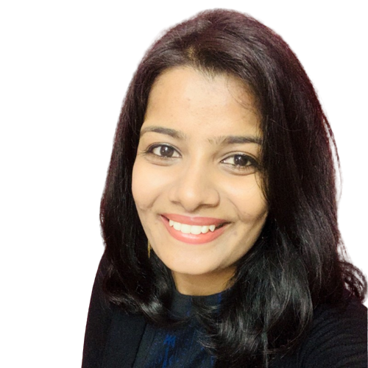
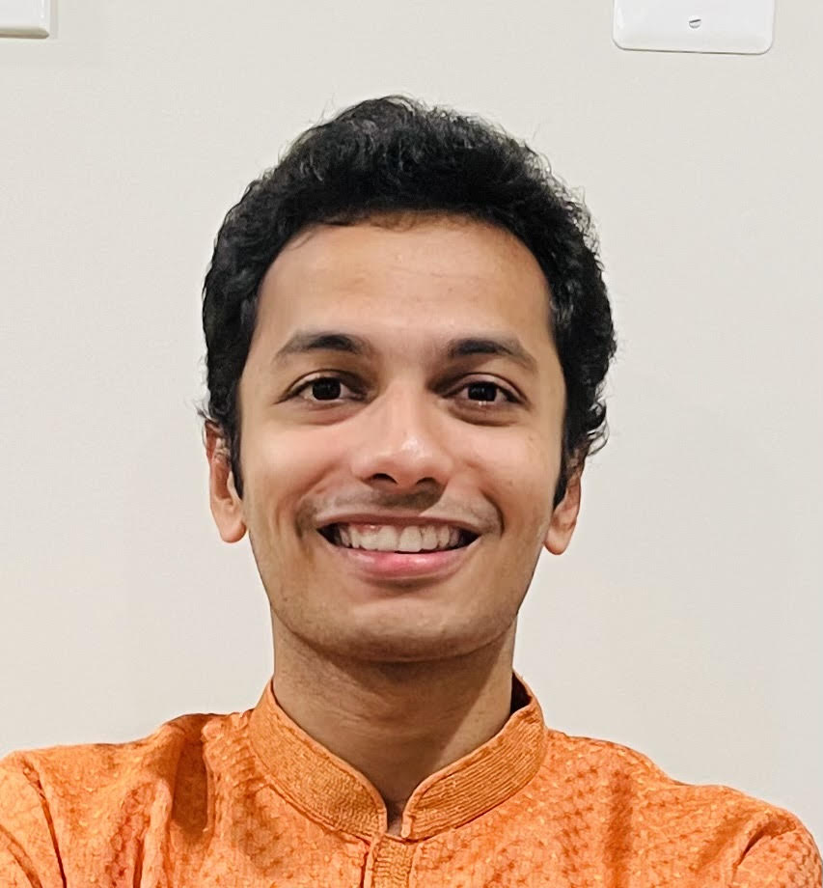
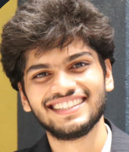

Our Team
Harshitha
Ramachandra
(Project
Manager)
Directed the team, delegated work and monitored progress
Assisted in creating the webform and the logout functionality
.
Successfully hosted the website.
Managed documentation, reports and submission.
Sharvil Shastri
(Designer)
Worked on designing the front-end layout of the project website
Assisted in developing the webform and the User Interface
Implemented the validation error popup in the webform when any particular field entry is missing
Shashank
Ramprasad
(Programming
Mentor)
Worked on PHP to design the backend.
Connecting and managing MySQL DB, designed the login page, output data table.
Contributed to the project write ups
Establishment of client relationship
Requirements gathering, documentation and analysis
Research on web hosting vendors
Documentation of testing scenarios
Sandra Staub
(Programmer)

Slide 7


Interesting implementation details
Implementing multi day, multi time functionality (it was a challenge to retrieve all the combinations of day/time, we tried different approaches)
Replicating the look of the iSchool website.
Hash encrypted passwords
Limitations
Our website is not entirely secure.
SQL injection attacks.
000webhosting is free therefore there are constraints on bandwidth and space.
Notes:
Ddos attack - program thousands of malicious bots and devices to send a flood of traffic to a website. No option to change file permissions, who can see what. Vulnerability that allows attacker to view/manipulate data stored in db by inserting their own sql query:UNION DROP TABLE alumni 300 MB disc space and 3gb BW.

Slide 8

Reflections
We learnt how to build a website from scratch. From understanding client’s requirements, designing the website, implementing the required features, connecting it to a database and hosting it on a suitable platform.
Understood the various security vulnerabilities that comes with creating a website.
JavaScript instead of php.
Recommendations to improve the website
Adding an export functionality to retrieve the output table.
Implement CRUD operations.
Making the website mobile friendly.
Notes:
As opposed to using a platform like wordpress which does all of it for us. Php is strictly backend, server side.. JS allows for interactivity

Slide 9

References
Application used to create mockup wireframes: Canva (https://www.canva.com/)
HTML and CSS information: https://html.com/
Website requirements complete guide: https://www.mindspun.com/blog/websiterequirements-document-a-complete-guide
YouTube videos on PHP: https://youtu.be/BUCiSSyIGGU
HTML and CSS implementation: https://www.w3schools.com/, https://www.tutorialspoint.com/
Web hosting: https://www.geeksforgeeks.org/7-best-sites-for-free-web-hosting/, https://docs.google.com/spreadsheets/d/1mdrdw9umzRWzZwGw3KWmKJIgkCiFhnmbayFY0VZiYUw/edit#gid=0
Our Web Hosting platform: https://www.000webhost.com/
UMD iSchool website: https://ischool.umd.edu/

Slide 10

THANK YOU!

